Slide 1
The Battle of Neighborhoods
Let's say we want to travel to Toronto. It would be very difficult to decide the neighborhood in which it would be better for as to stay during our holidays. But with this report and analysis of the data taken from Foursquare it is much easier to learn the basics for each neighborhood and make a decision.

Slide 2
Data collected:
Using Foursquare API we will retrieve the information needed to do our report and end up to a conclusion:
Museums
Monuments
Restaurants
Coffee shops
Bars
Shopping Centers
Theaters

Slide 3
Data Visualization
After collecting all that information for Toronto we will visualize them using folium in a map with different colors for each category so that anyone will be able to see what's where and decide where they prefer to stay during their vacation according to their preferences in amusement.

Slide 4
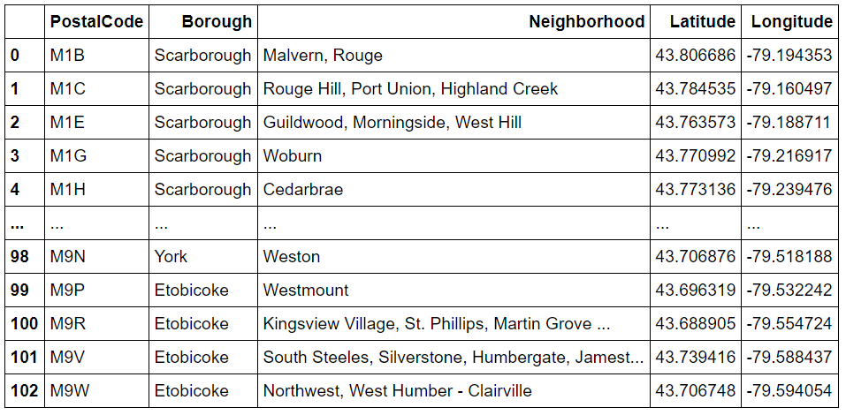
The data frame of postal codes and latitude, longitude of neighborhoods

Slide 5
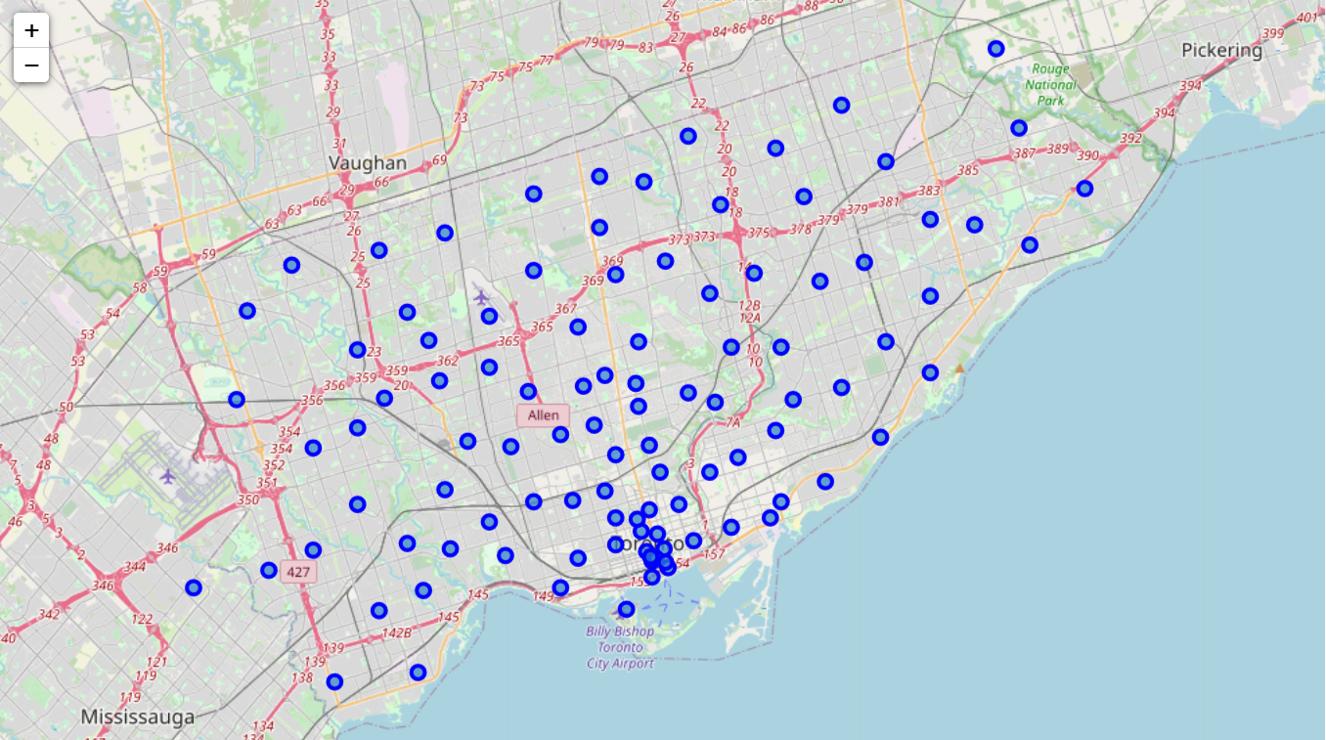
The map of Neighborhoods (using Folium)

Slide 6
Data frames by Foursquare API
Using Foursquare API we create a get request and we take a JSON which we transform to a data frame of name , latitude and longitude of the places returned in each case.

Slide 7


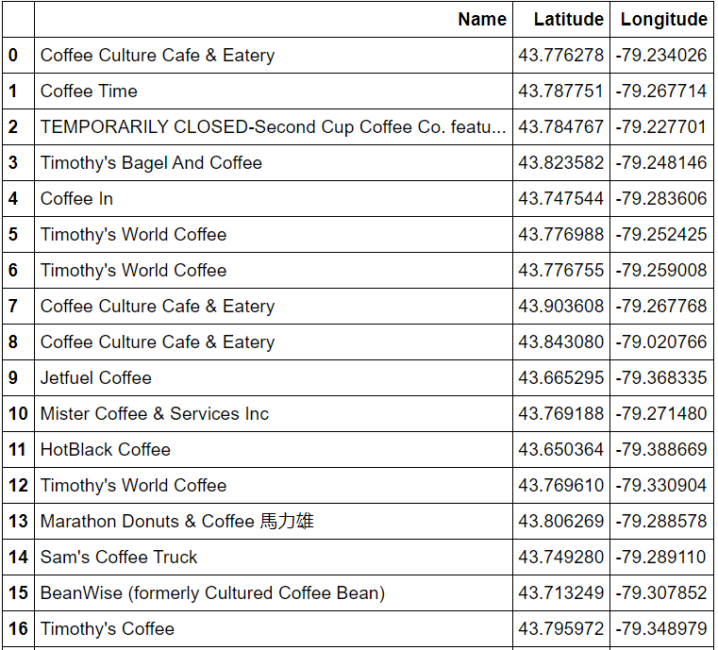
Data frame of Coffee Shops

Slide 8
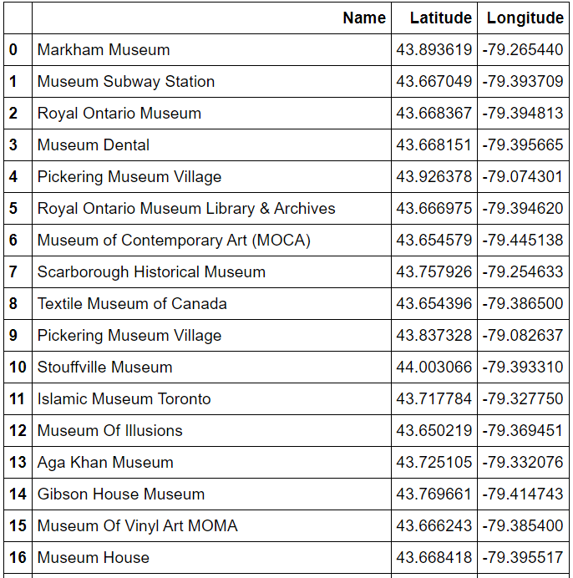
Data frame of Museums

Slide 9
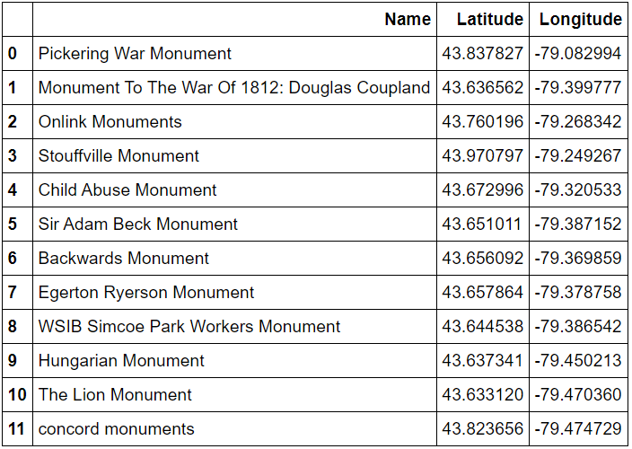
Data frame of Monuments

Slide 10
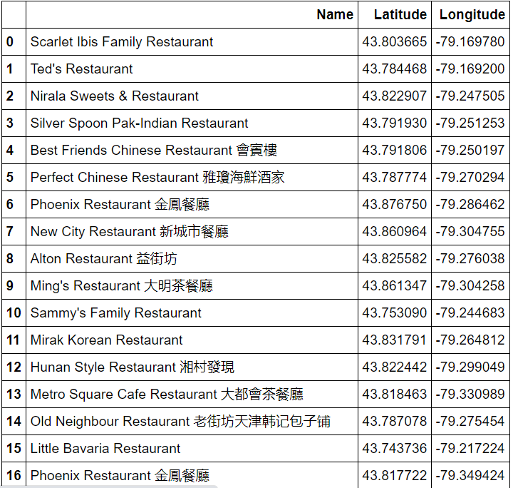
Data frame of Restaurants

Slide 11
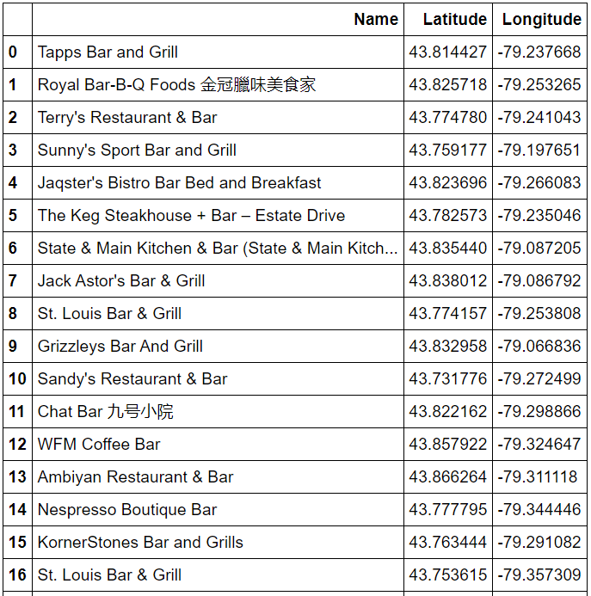
Data set of Bars

Slide 12
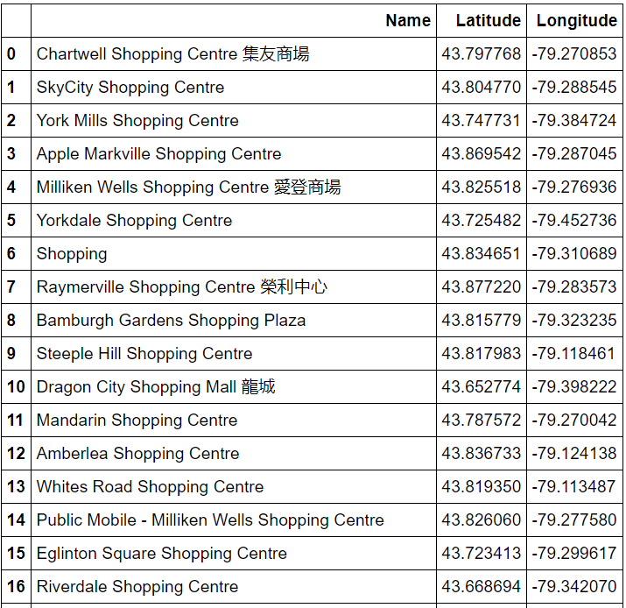
Data frame of Shopping Center

Slide 13
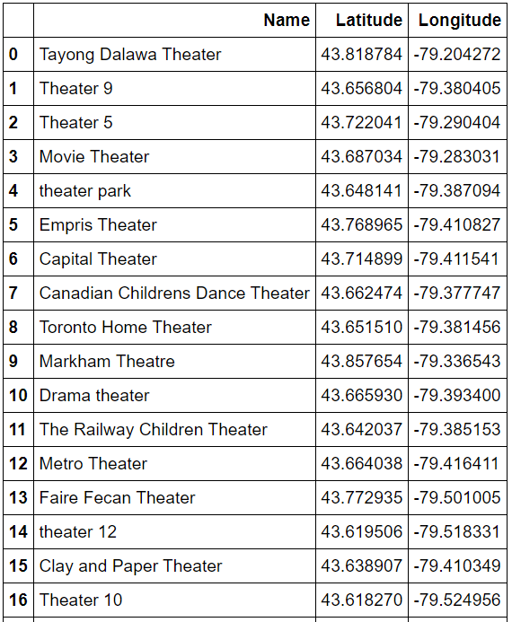
Data frame of Theaters

Slide 14
Now, using Folium, we will present the different categories of venues in the map of Toronto. We will use different colors for each category for better understanding.

Slide 15
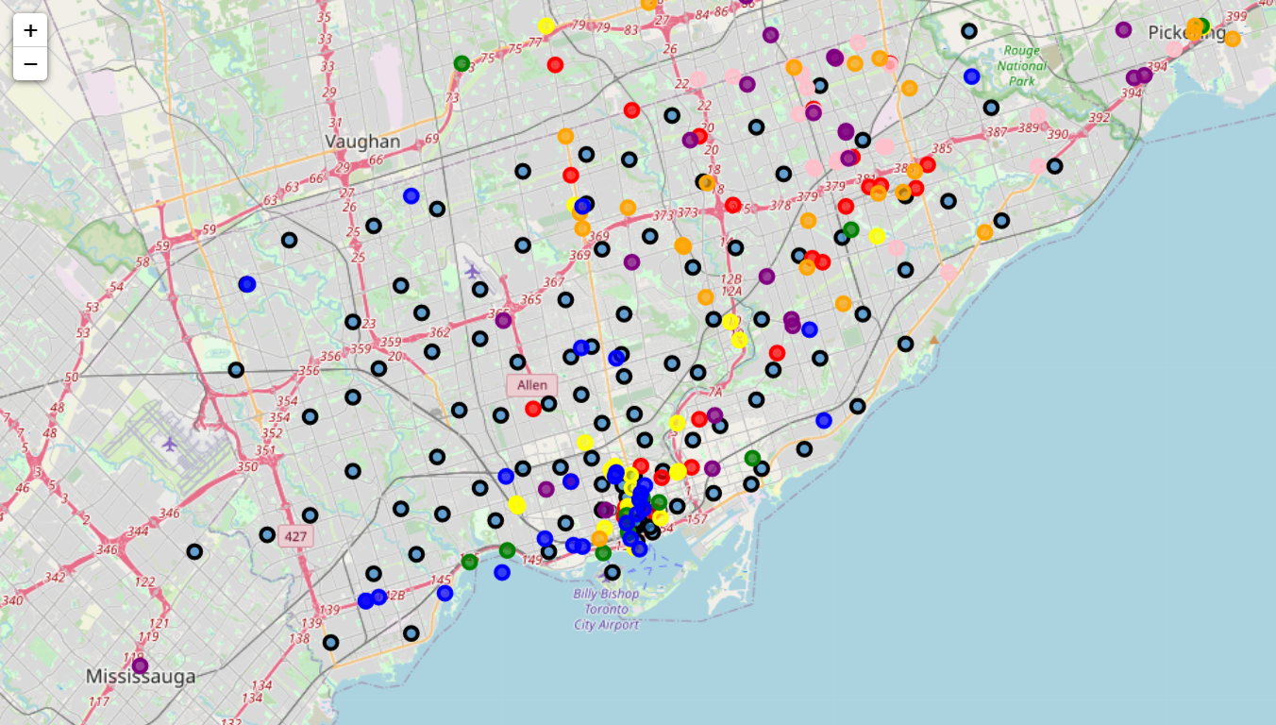

Slide 16
Map analysis:
Black: Neighborhoods
Red: Coffee Shops
Yellow: Museums
Green: Monuments
Pink: Restaurants
Orange: Bars
Purple: Shopping Centers
Blue: Theaters

Slide 17
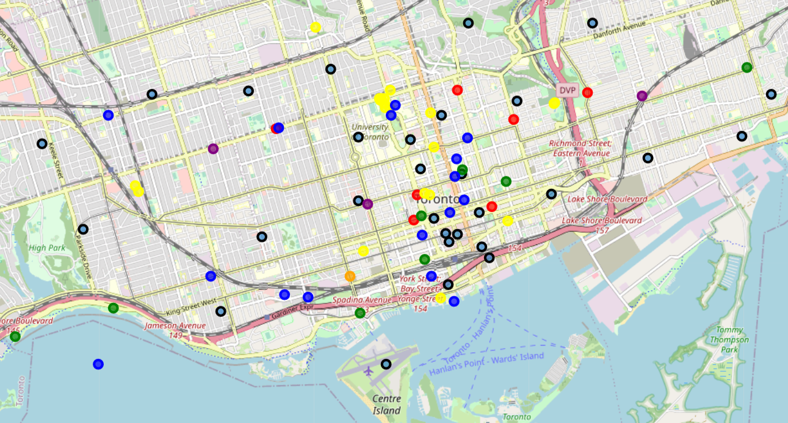
Zooming in…

Slide 18
Zooming in the area that is obviously the one with the most bullets we can see clearly what’s around and according to our preferences we can choose the neighborhood in which we will look for a Hotel to stay in during our holidays in Toronto.

Slide 19
Thank you for your time!

